Slide 1
CRIME ANALYSIS Big Data Analytics Program
Group Status Meeting
Prepared By: Formulators

Slide 2
1. SUMMARY 2. PROJECT STATUS 3. WORK DONE 4. WORK PROGRESS 5. PLAN
TABLE OF CONTENTS

Slide 3
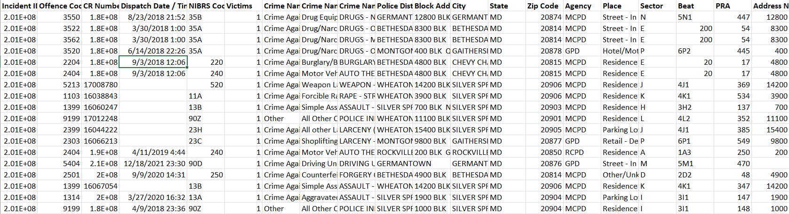
Summary
For the project, used opensource dataset on the Major crimes happening in the United States of America. We have tried to drill down on the technologies, software selected, and explored other market solutions to reach a better conclusion.
The aim of the project is to look for any seasonality or trend from the historical data to understand if certain crimes are happening at some specific region.

Slide 4
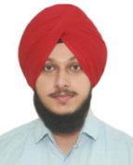
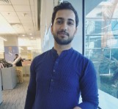
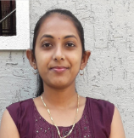
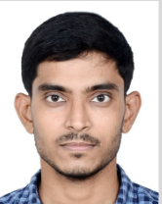
Team Profile
Team Lead
Business Analyst
Developer
Developer
Harbir Singh
Abhishek Sharma
Divyaben Patel
Brij Kumar Patel

Slide 5
PROJECT STATUS Completed 🎉
Date of report : 04/12/2023 Date of last report : 03/30/2023

Slide 6
WORK DONE
01
02
03
04
2022-10-19
In the initial meeting with the client, the basic overview of the requirements, post which the team had started working on the requirement gathering
2022-12-03
the proposed solutions were discussed, and few new suggestions were provided. However, as we await approval from the client no formal meeting took place.
2022-12-10
In this meeting, the python libraries and visualization tools were finalized
2022-10-15
The final project charter was created and presented to the client, now the team is awaiting approval.

Slide 7
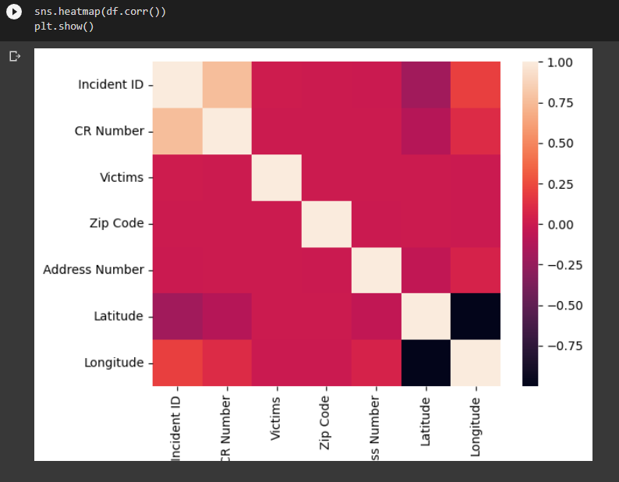
WORK DONE
05
2023-01-25
Done with creating the SQL schema tables and cleaning of data
06
2023-02-02
Created data dictionary and visualized the correlation matrix
Created heat map based on crime rate using Python coding

Slide 8
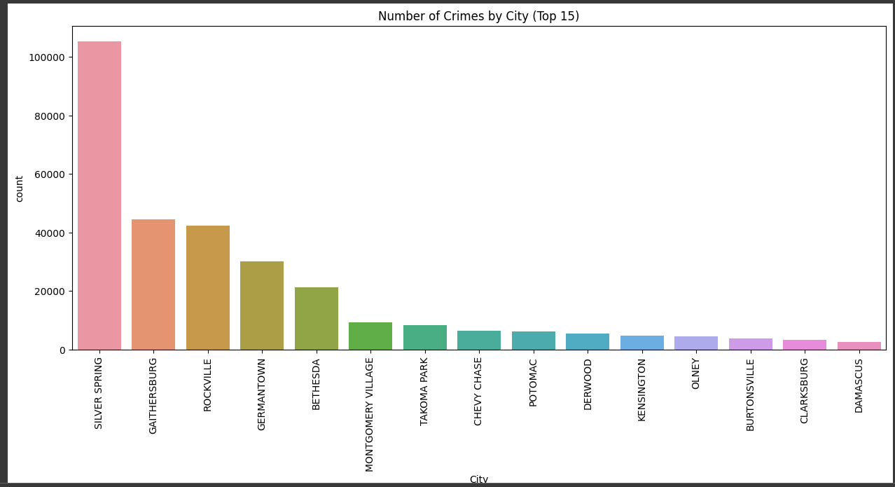
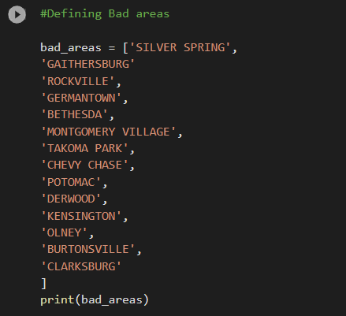
WORK DONE
07
2023-01-25
Defined the areas with major crimes using matplotlib
08
2023-02-02
Defined and created a calculated column based on incidents in cities into Safe & Not Safe.

Slide 9
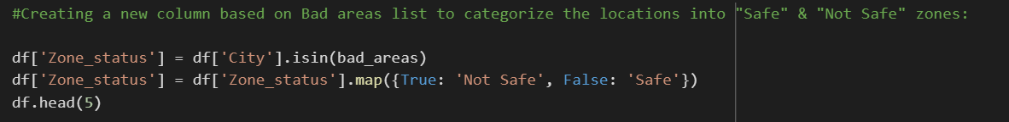
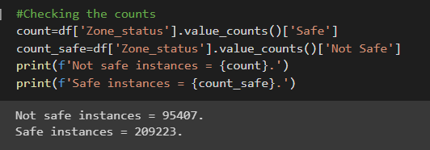
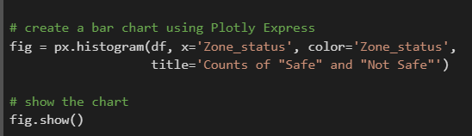
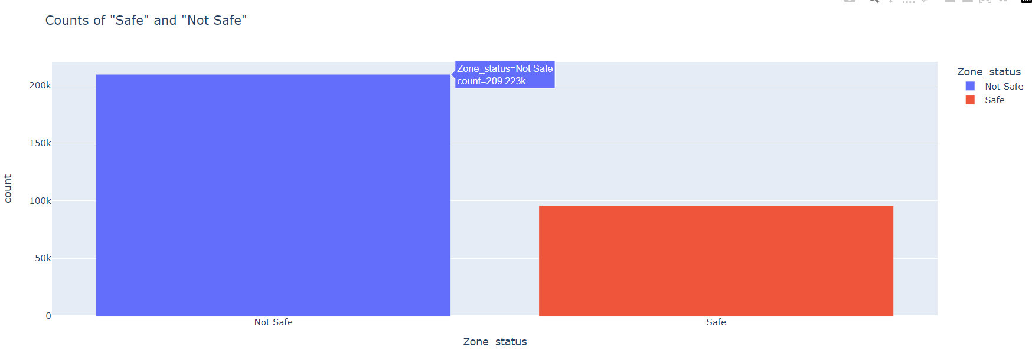
WORK DONE

Slide 10
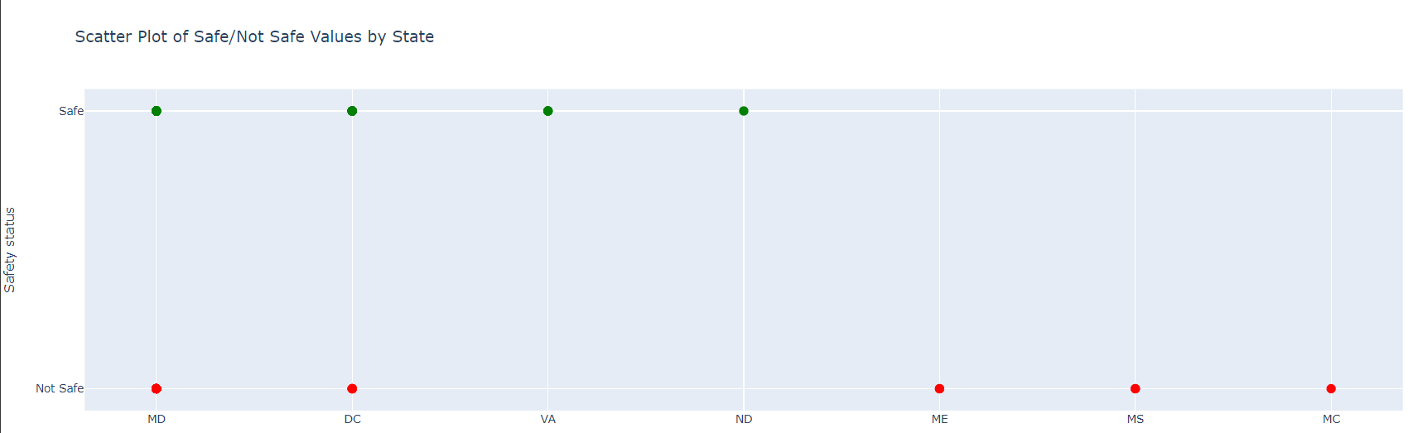
WORK DONE
Plotting the crime instances across different States to categorize them into Safe and Not safe.
09
2023-02-09
Created classification model using Linear Regression

Slide 11
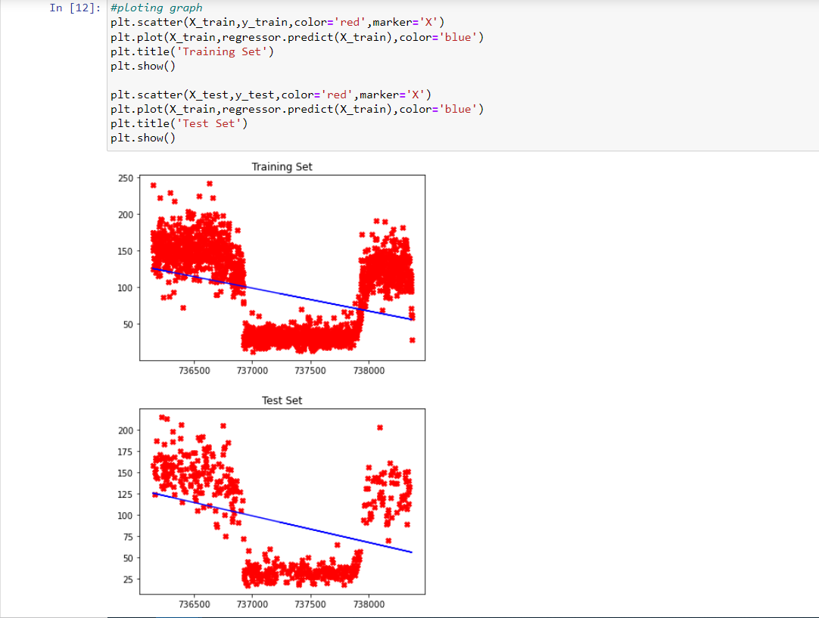
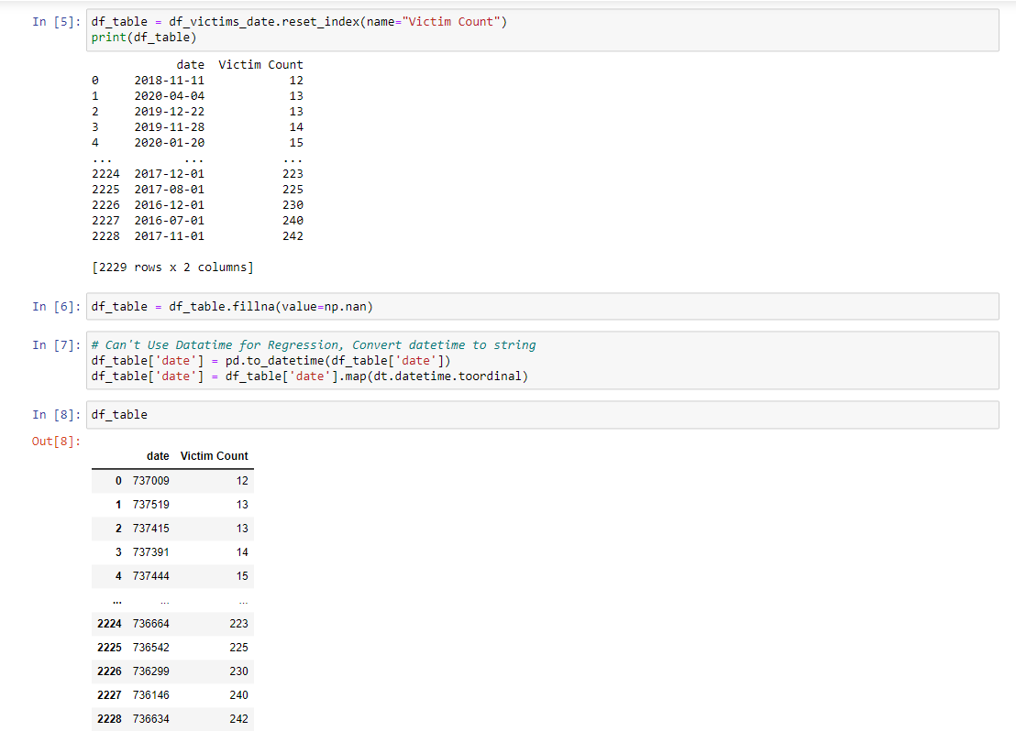
WORK DONE
10
2023-02-21
Create Decision Tree Regression Model in Rapid Miner Studio
11
2023-02-26
Create Linear Regression Model using Python Programming

Slide 12
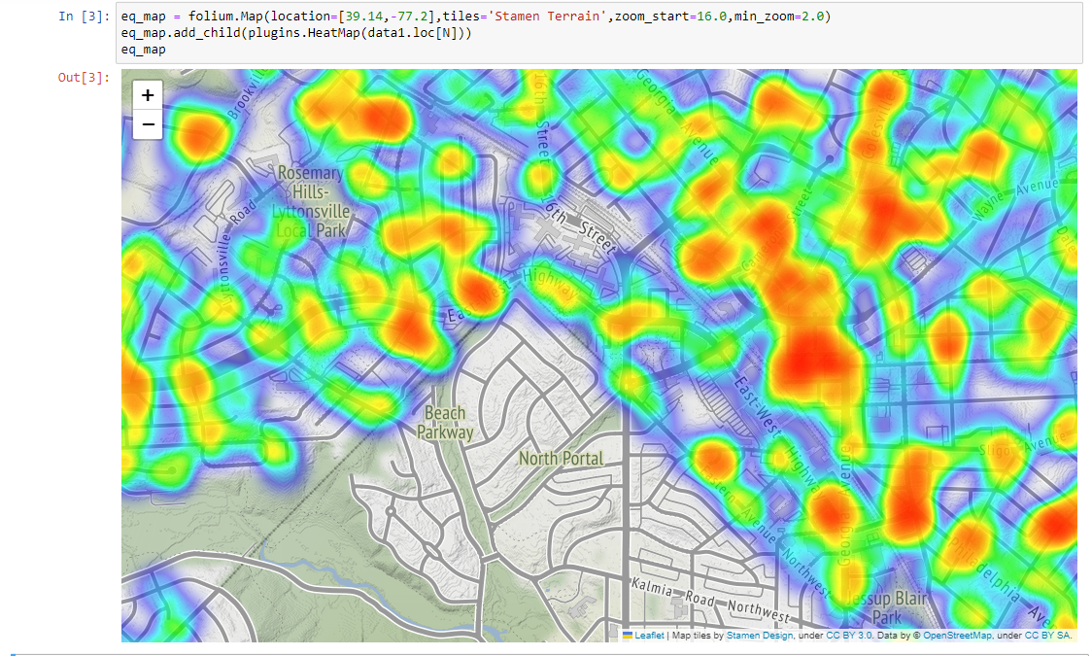
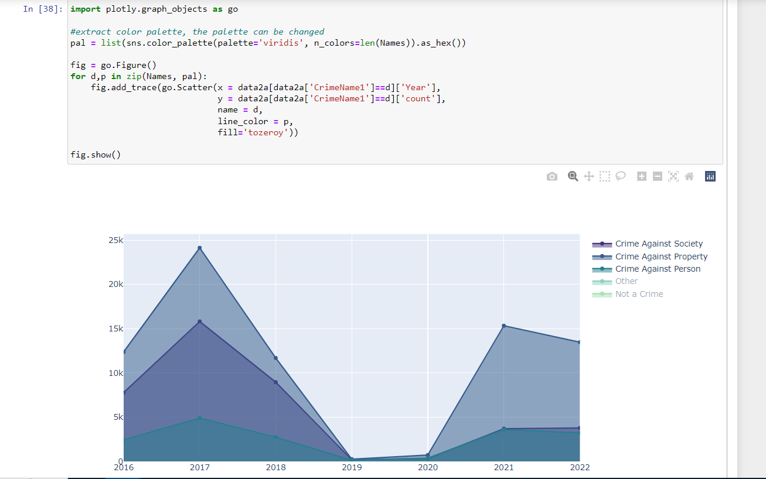
WORK DONE
2023-02-14
Using the Python in-built library Matplotlib, the refined hotspots were identified.
12

Slide 13
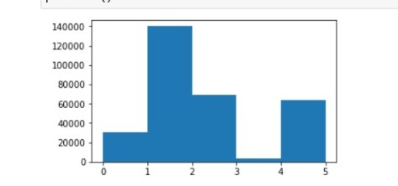
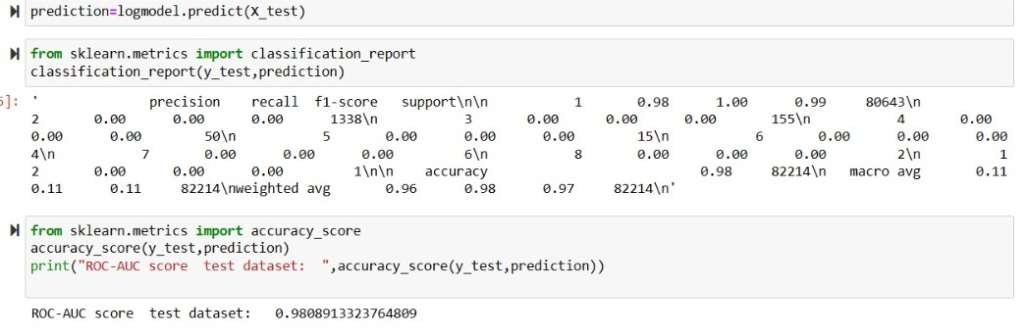
WORK DONE
13
2023-02-26
Create Logistic Regression Model using Python Programming

Slide 14
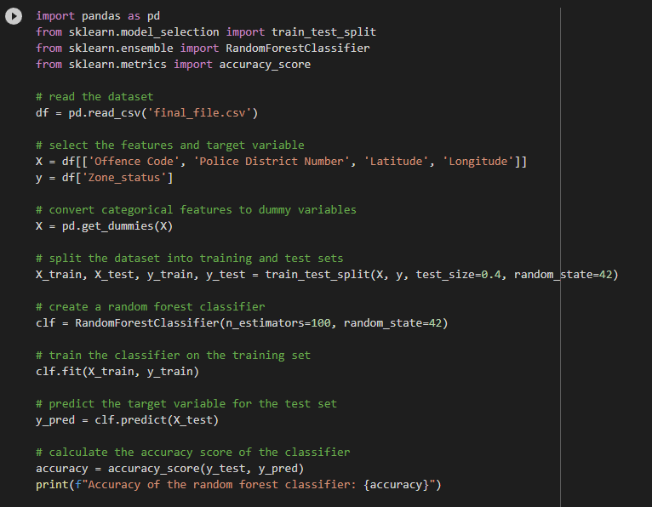
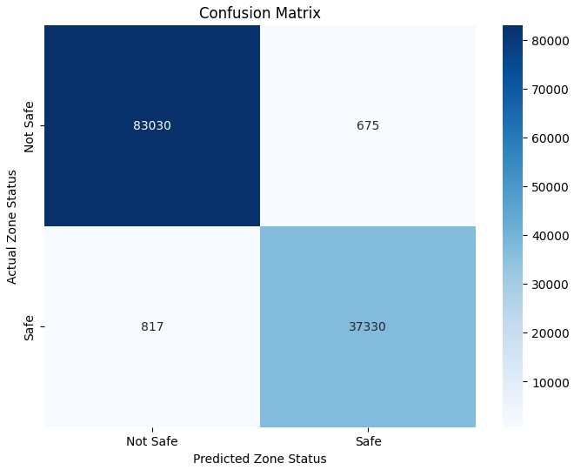
WORK DONE
14
2023-03-12
Created Random forest classification model

Slide 15
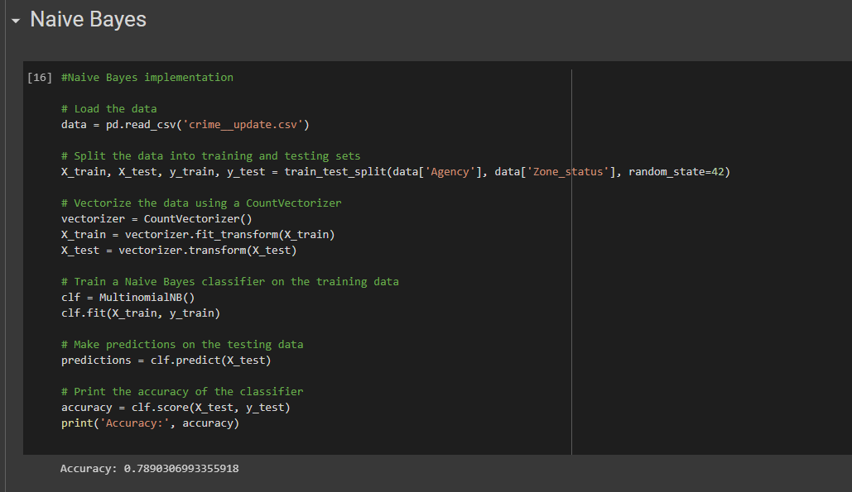
15
2023-03-20
Created Naive Bayes classification model

Slide 16
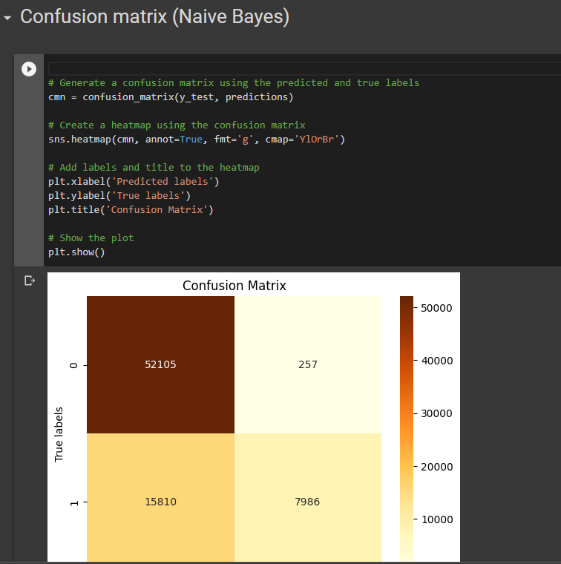

Slide 17
WORK PROGRESS
Week 2022-11-26 > 2022-12-03
Our team started the development of the Project Proposal based on the meeting with the client
There are some questions related with the scope that will be clarified in our next meeting on 2022-12-08
01
Week 2022-12-03 > 2022-12-10
Test data loaded into python frame using pandas and Exploratory data analysis performed on the data to identify variables for future analysis and visualizations.
02
03
Week 2022-12-10 > 2022-12-15 Basic setup of cloud was created for data migration was created.
04
Week 2023-01-16 > 2022-12-18 Using the approved dataset, the SQL schemas were created.

Slide 18
WORK PROGRESS
Week 2023-01-26 > 2023-01-19
The basic data cleaning was performed by removing some columns along with eliminating the null values
05
06
Week 2023-02-02 > 2023-01-26 Done Hypothesis testing and testing various variables for defining and creating dictionary.
07
Week 2023-02-09 > 2023-02-02
Used Matplotlib to showcase the hotspots of crime.
08
Week 2023-02-16 > 2023-02-09
Create Decision Tree Regression Model using RapidMiner Studio.
09
Week 2023-02-21 > 2023-03-16
Create various Models in Python Programming.

Slide 19
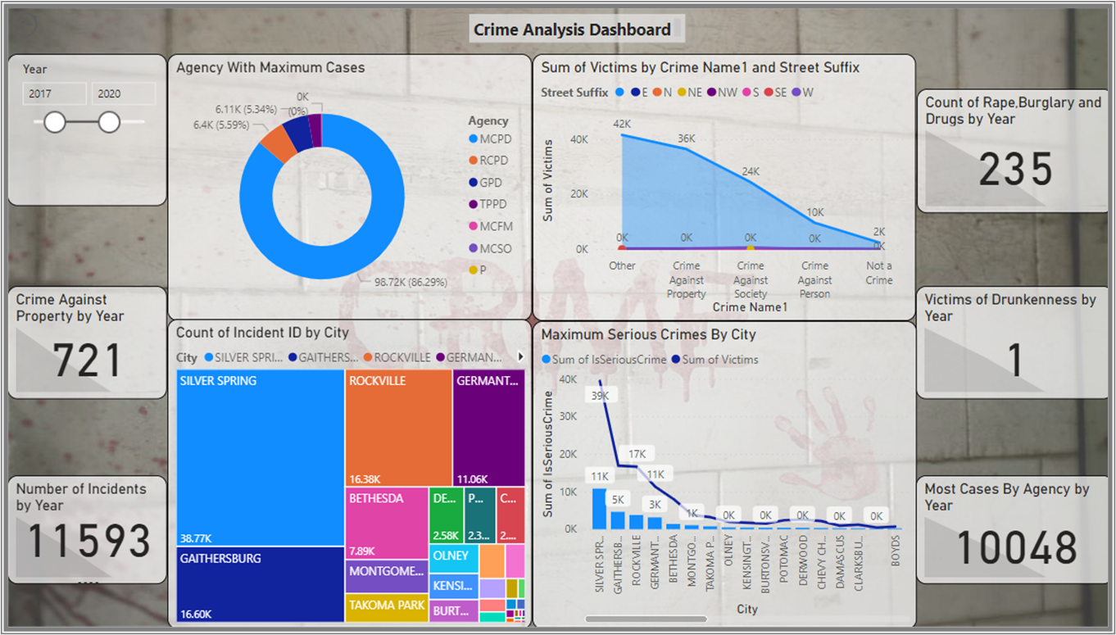

Slide 20
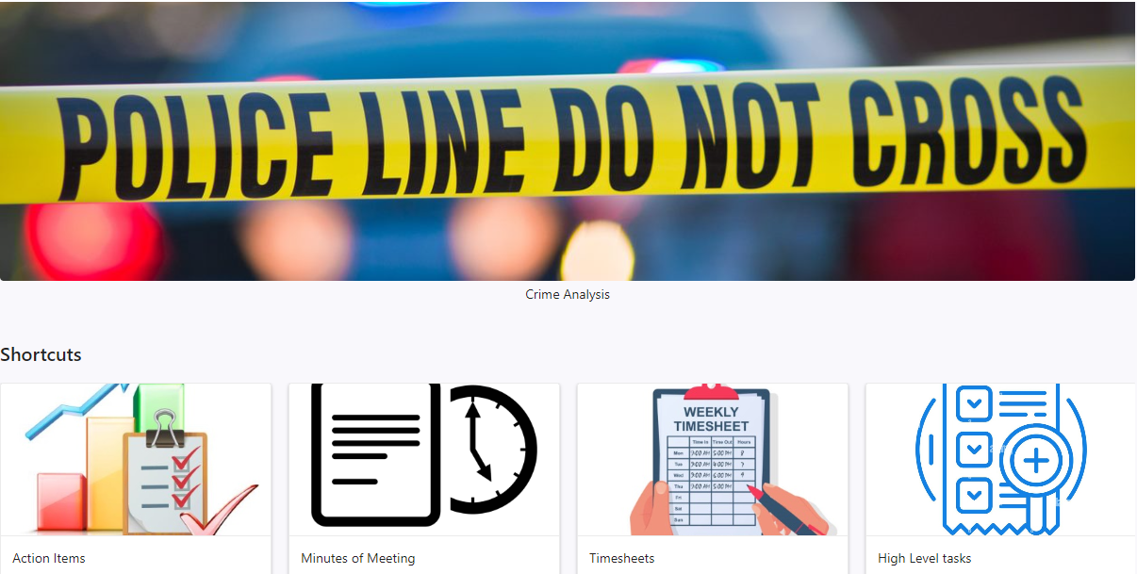
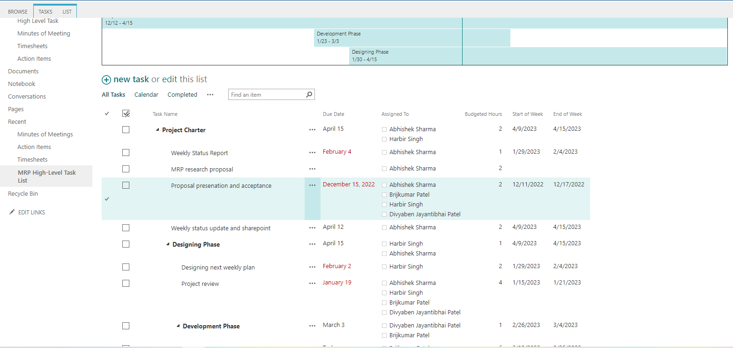
SHAREPOINT PROGRESS

Slide 21
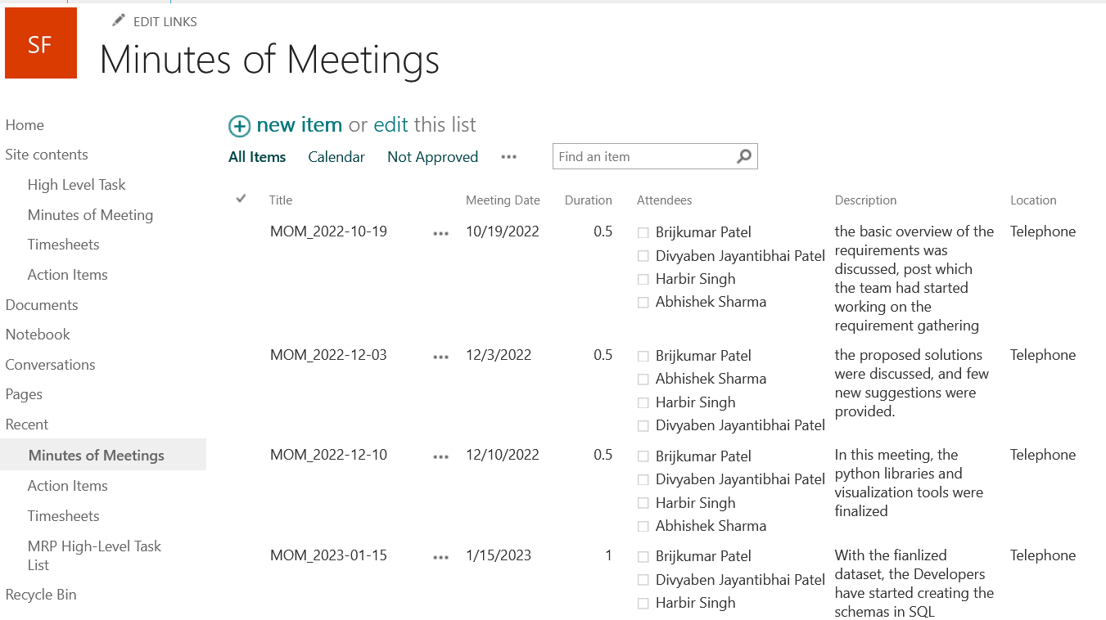

Slide 22
BACKLOG
2022-12-08
Deliver the final project charter
Finalize the Proposal
01
2022-12-16
Send Proposal to be signed by the client
02
2022-12-15
Deadline to receive the signed doc version of the Proposal and Project Charter in the final version and signed by the client.
03
04
2023-03-23
To perform and compare different predictive models

Slide 23






COST THEORETICAL V/S ACTUAL
Theoretical budgeted hours for the complete project were:
100 hours, budget $4,200
And the actual action hours by the team into the project till date are 96 hours, actual $4,032

Slide 24

THANK YOU

